Slide 1
HUMAN CAPITAL DEVELOPMENT AND JAPA SYNDROME; CHALLENGES AND OPPORTUNITIES.
A PRESENTATION BY ENGR DR SULE YAKUBU BASSI, SECRETATY, NIGERIANS IN DIASPORA COMMISSION (NIDCOM), ABUJA, AT THE 22ND MEETING OF THE JOINT PLANNING BOARD (JPB) AND NATIONAL COUNCIL ON DEVELOPMENT PLANNING (NCDP), IN OSOGBO, OSUN STATE, ON WEDNESDAY, SEPTEMBER 13TH, 2023.

Slide 2
INTRODUCTION.
Protocols
Appreciation
Topic: “Human Capital Development and Japa Syndrome; Challenges and opportunities”.
Theme: Imperatives for restoring Nigeria on the path of Sustainable Economic Growth and Development.

Slide 3
HUMAN CAPITAL DEVELOPMENT.
Human Capital consists of the knowledge and skills that people accumulate throughout their lives, enabling them to realize their potential as productive members of society. Through this, poverty alleviation can occur, with the creation of more inclusive societies if it is developed.
Gained through: * Education/training.
* experience.
* exposure (global)

Slide 4
The world of today is a global village (technology & travel). You can be anywhere and carry out your business globally.
The world is a knowledge economy. Skills rule the labour market not qualifications.
Global careers and global labour markets.
Fundamental human rights for migration, which has resulted in the brain drain/brain gain phenomena (Japa Phenomena)
Labour migration: As it is legitimate and legal
The emergence of the Diaspora phenomena from migration. Nigeria has over 17 million persons outside its borders!
Therefore, we have to manage the situation through executing designed strategies.
Think local but act global is the new adage
SOME
PERSPECTIVES FOR HUMAN CAPITAL DEVELOPMENT

Slide 5
“Japa” syndrome.
Japa, is a Yoruba locution which means to leave for greener pastures.
The literal connotation denotes 'to leave for good'. It has become the new catch phrase for unbridled migration by desperate Nigerians in search of better paying jobs or other life supporting means of livelihood.
In our context “Migration out of Nigeria (regularly) for greener pasture”
Japa Syndrome and brain drain are one and same phenomena.

Slide 6
MIGRATION
A human right issue: regular migration.
Globalization made the world a village.
Facilitate by: ICT (internet), travel , social media, etc.
Global careers /jobs/skills/talents.
Collapse of geographical boundaries: Citizens of the world.
Labour mobility: all countries/demand driven.

Slide 7
CAUSES
Demographic factors: Population explosion.
Economic Factors: Purchasing power/livelihood issues.
Environmental factors: Climate change.
Socio-political factors.
Bad governance.

Slide 8
NEGATIVE IMPACT
The country which the professional is leaving, faces a decrease in the number of professionals/trained manpower albeit in the short term.
The country the skilled individual leaves remains underdeveloped.
It creates societal animosity. Those leaving are perceived as unpatriotic!
Underdevelopment.

Slide 9
CHALLENGES
Nigerians continue to leave their home country in search of a better life and some tend to go through traumatic experiences such as:
- Exploitation by so-called Visa processing agents.
- Violence and exploitation of women; physical abuse, torture, rape, enslavement and other forms of psychological abuse.
* Often, women are promised regular/legitimate jobs, but when they arrive at their destination country they are forced into prostitution.
- Giving the country a bad name internationally, when caught doing things of an illegal nature.
Socio-cultural issues of survival.

Slide 10
OPPORTUNITIES
-It helps the individual develop financially.
The individual gets more exposure to new methods of professionalism and leads a higher standard of life.
- The individual is able to increase their professional skills through learning new from professionals in the host country.
It is also part of globalisation through:
Human Capital development and sharing
Enhances knowledge economy
Development of Global Best Practices (GBP)
Seeks global citizens

Slide 11
SOLUTIONS TO JAPA /BRAIN DRAIN
Brain Drain can be defined as the situation in which large numbers of educated and very skilled people leave their own country (origin) to live and work in another country (destination), where pay and conditions may seem better.
DEFINATION:

Slide 12
PUSH FACTORS:
Political: Slow development, Nepotism, Bad governance, War
Economic: Poor pay, Lack of the will to create jobs
Environmental: Drought, Diversification
Legal: Persecution, Jungle justice, Lack of rule of law
Slow or Non-monetization of knowledge after school: Why go to school?
PULL FACTORS:
Social security
Income from paid jobs
Employment opportunities
Economic system: Welfarist
Society with empathy and patriotism
Peaceful environment

Slide 13
STRATEGIES FOR MITIGATING BRAIN DRAIN:
Discourage citizens from leaving in the first place, by giving them reasons to stay, such as:
Economic Opportunities
Better environment
Stable living Standards
Security (physical, political, social, environmental).
Good governance

Slide 14
WHAT IS BRAIN GAIN?
Brain gain refers to the benefits gained from the immigration of skilled individuals into a country.
The receiving country gains in terms of:
Knowledge
Skilled Personnel/manpower
Diversity (culture and ideas)
Economic growth
Accelerated development

Slide 15
BRAIN CIRCULATION
Brain-circulation is a phenomenon typical of the modern era in which professionals migrate looking for work in different markets. This phenomenon is no longer seen as a loss, as is the case of brain-drain, but quite the opposite -the moving of intellectual resources can serve as a source of benefits for all the countries participating in the exchange (the ones which the experts are leaving and those they are coming to).
BRAIN
DRAIN
BAIN
GAIN
BRAIN
CIRCULATION
Lets turn Brain Drain to a WIN-WIN phenomena

Slide 16
BRAIN CIRCULATION
Encouraged by:
Globalisation: Countries are interdependent
Reduction in migration barriers
Dual citizenship phenomena
Emergence of careers without borders (global best practices)
Fundamental human rights of positive migration.

Slide 17
Who is a Diaspora?
A Diaspora is somebody who legitimately and legally lives outside his country (country of origin), for more than one year continuously, and has a sustainable means of income and an address in the country of stay (host country). They by implication, are ambassadors-at-large of their country of origin by presence, comportment and character.
The Diaspora phenomena is the product of legitimate migration.
Over 17million Nigerians in Diaspora.

Slide 18
Strategies for harnessing Nigerians in Diaspora for HUMAN CAPITAL DEVELOPMENT.
Engage with them (identify and know them); Diaspora Registration Portal – www.nidcom.gov.ng (skillset and location).
Enable them to participate (invite them); Do not be hostile to them. They also should not look down on their origin.
Empower them by creating an enabling environment (provide incentives for them to participate in National Development e.g. land, infrastructure, tax breaks, etc); Encourage them to invest their resources, talents, skills and global expertise into the Nigerian economy.

Slide 19
How to engage the Nigerian Diaspora
Identify those to engage: seek them out!
Communicate with them: create platforms for this to happen (electronic platforms for serious engagements, NOT jokes).
Assign appointments to strategic positions where they have comparative advantage (also elective positions)
Challenge them to take up specific programmes and projects within Federal and State development plans.

Slide 20
Tools Needed
Technology Tools: Website, Database of Diasporans from the State. Start with those known and grow the Database, Electronic Communications Platform.
Development plan for each State in terms of programmes and projects.
Challenge them to GET INVOLVED on the programmes/projects either as individuals, small or large groups.
Recognize them and their successes through MERIT AWARDS/Diaspora Champion Awards.
State National Diaspora Day Celebrations (July 25th annually).

Slide 21
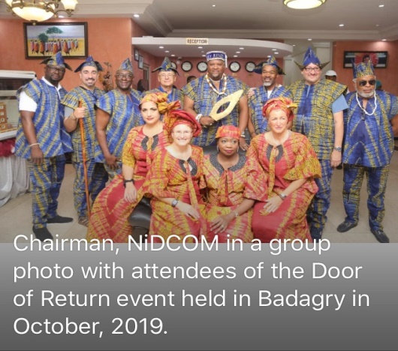
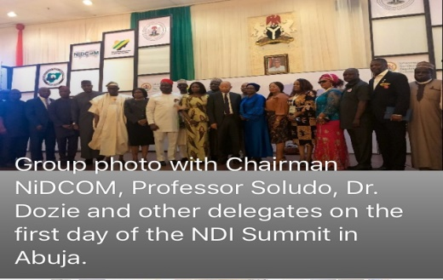
PROGRAMS OF NiDCOM IN ATTRACTING THE DIASPORA
The Celebration of the Annual National Diaspora Day on the 25th of July of every year.
The Diaspora Registration Portal
The Annual Nigerian Diaspora Investment Summit (NDIS).
The Badagry Door of Return Festival – connecting with the Historic African Diaspora (HAD).
The State Diaspora Focal Point Officers Summit.
The Diaspora Housing Scheme.
The Diaspora Medical and Charity Missions and the Diaspora Professional Healthcare Initiative (DPHI) in collaboration with the Ministry of Health.
Diaspora Presidential Town Hall Meetings at the continents.
Diaspora mapping and creation of Diaspora database.

Slide 22
BENEFITS OF NiDCOM’S STRATEGIES.
Though NiDCOM is just four (4) years old, its strategies have started yielding results, as can be seen through:
Remittances (approximately $20-25b), annually
NiDCOM is currently working on the establishment of the Nigerian Diaspora Investment Trust (NDIT), in an effort to increase the proportion of remittances to investments by the Diaspora.
Healthcare Features: Hospitals, Medical Missions (annually)
Agriculture: Farms, factories processing Agric products
ICT: Trainings
Housing & Real Estate Development – Housing estates in Abuja, Lagos, etc.
Education – Gregory University, Abia State.
Transportation – Sokoto State.
Volunteerism: Palliatives, Community Support – Zumunta Association, USA empowered 18 NGO’s in 12 States in April, 2022.

Slide 23
SUCCESS STORIES
Nigerian Professional – Footballer Moses Simon who plays in Ligue 1 side FC Nantes in France has drilled three industrial boreholes and wells in Obagaji Agatu in Agatu Local Government Area of Benue State thereby solving the perennial water problems of his community. He is also building roads and drainages in Obagaji Agatu.
Atlanta –USA based Nnewi indigenes of Anambra State have offset hospital bills of 12 stranded Nursing mothers at Nnamdi Azikiwe University Teaching Hospital (NAUTH), Nnewi in December, 2020. This is the third annual mission of the association.
Ihiala Local Government Union in Netherlands distributed 50 hospital mattresses to five Health Centres in Ihiala Local Government of Anambra State in January, 2021.
The Nigerian Doctors in Africa Association in collaboration with Orthopedic Hospital, Enugu State carried out a successful Medical Mission in Janaury 2021. Eighty Four (84) surgical cases were received and treated successfully. This exercise will hold every four months in the year 2021.
Footballer Ahmed Musa, the Captain of the Super Eagles of Nigeria has commenced the building of M & S International School in Bukuru, Jos South Local Government Area, Plateau State. He is also running a football Academy in Jos, Plateau State. These are his “give back” projects as a Diaspora to his community.
The Delta State Diaspora are working on establishing a Diaspora University of Technology in Asaba, Delta State.
Many other Nigerians in the Diaspora are running many community projects either as individuals, groups or communities all over the country. These are classified either as investments, volunteerism or charity.
Twelve private world class hospitals built by the Diaspora in Nigeria since COVID-19
BRAIN DRAIN BRAIN GAIN BRAIN CIRCULATION.

Slide 24
CONCLUSIONS.
The Japa phenomenon is a global issue and not restricted to Nigeria due to globalization. It must be harnessed for positive outcomes.
“Paja” is also a phenomenon that should be encouraged and the media highlight it (returnee diaspora either physically, skills or remittances).
“Only Nigerians both those at home and the Diaspora can develop Nigeria. Others can complement.” (Bassi 2022)
“Whatever we achieve outside in foreign lands, Home is Home, and no one else can build and develop our Home” (Ayalogu 2007)

Slide 25
THANK YOU.

Slide 26
REFERENCES/WORKS CITED
Joseph U. Ayalogu. Ambassador of Nigeria to Switzerland (2004 to 2007
Bassi Sule Yakubu (2022) strategies for managing Brain Drain for national economic Growth. Paper presented at National Productivity Summit, National Productivity Centre, Abuja. May, 2022
https://www.worldbank.org/en/publication/human-capital/brief/about-hcp#:~:text=Human%20capital%20consists%20of%20the,societies%20by%20developing%20human%20capital.
Nigeria and the Burden of Japa Syndrome, April, 2023 - https://www.thisdaylive.com/index.php/2023/05/02/nigeria-and-burden-of-japa-syndrome#:~:text=Japa%2C%20is%20a%20Yoruba%20coinage,or%20other%20life%20supporting%20means. –

